Slide 1
You want to be more productive, but in the world of cellphones, instant messaging, social networks and cube life, it can be tough. In this session, you'll learn how to get more than 15 minutes of actual work done in a week by doing 3 simple things. Be m/ore productive and have more time to do the fun things you really want to do.

Slide 2

3 Simple Things for Increased Productivity
KCDC 2014
Michael Eaton
@mjeaton

Slide 3


Slide 4
about.me/mjeaton

Slide 5
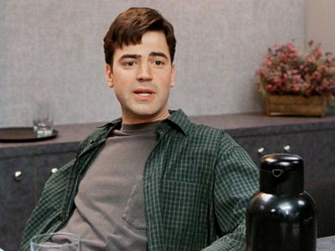
“I'd say in a given week I probably only do about fifteen minutes of real, actual, work.”

Slide 6
Productivity: the quality, state, or fact of being able to generate, create, enhance, or bring forth goods and services.
In business, a measure of worker efficiency, such as one hundred units per hour.
Notes:
Productivity: the quality, state, or fact of being able to generate, create, enhance, or bring forth goods and services.
In business, a measure of worker efficiency, such as one hundred units per hour.

Slide 7
Identify

Slide 8
distraction (dɪˈstrækʃən)
— n
1. the act or an instance of distracting or the state of being distracted
2. something that serves as a diversion or entertainment
3. an interruption; an obstacle to concentration
4. mental turmoil or madness
Notes:
distraction (dɪˈstrækʃən)
— n
1. the act or an instance of distracting or the state of being distracted
2. something that serves as a diversion or entertainment
3. an interruption; an obstacle to concentration
4. mental turmoil or madness

Slide 9

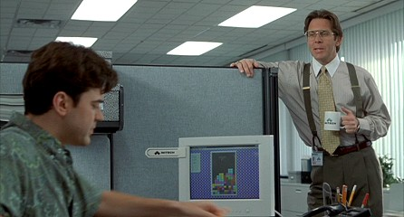


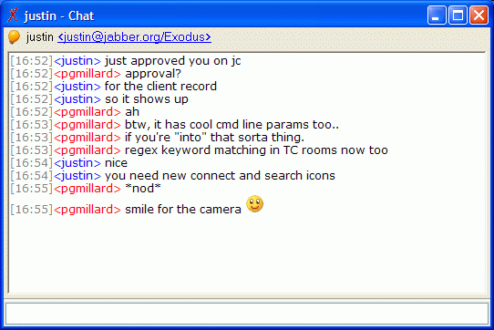




Notes:
Social networking
Silly time wasting games
Xbox
More time wasting games
*sigh* World of Warcraft / amount of time spent over the years
People
Email
Chats
More time wasting games

Slide 10
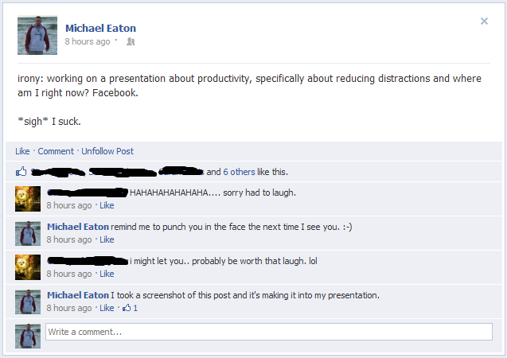

Slide 11
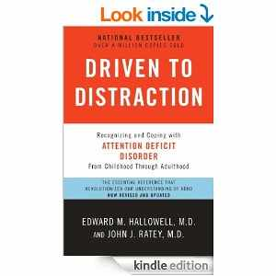
Notes:
Driven to distraction

Slide 12
Reduce or eliminate

Slide 13
Notes:
Totally eliminating things may or may not work.

Slide 14

Notes:
Find ways to help you focus

Slide 15
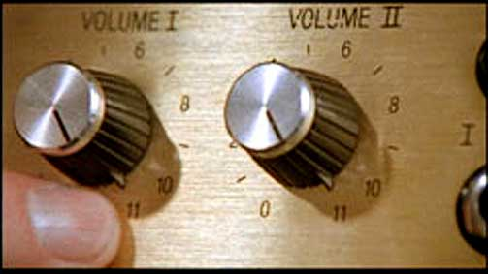
Notes:
My preferred method is turning the metal up to 11

Slide 16
On my cube wall circa 1998
“Don’t waste your breath on me and I won’t waste my hate on you.”
Lyrics from Metallica’s “Wasting my hate”
Notes:
This may or may not work. ☺

Slide 17
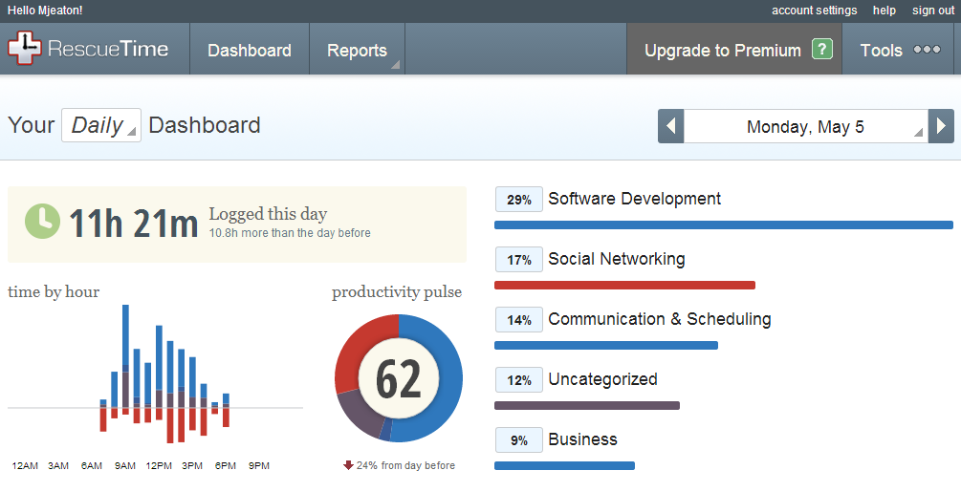
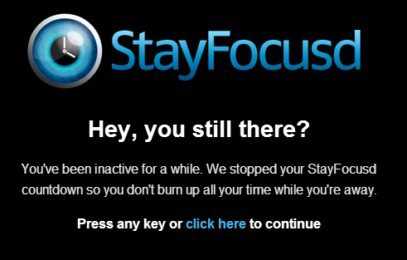
Notes:
StayFocusd Dashboard
Reminders and nags

Slide 18
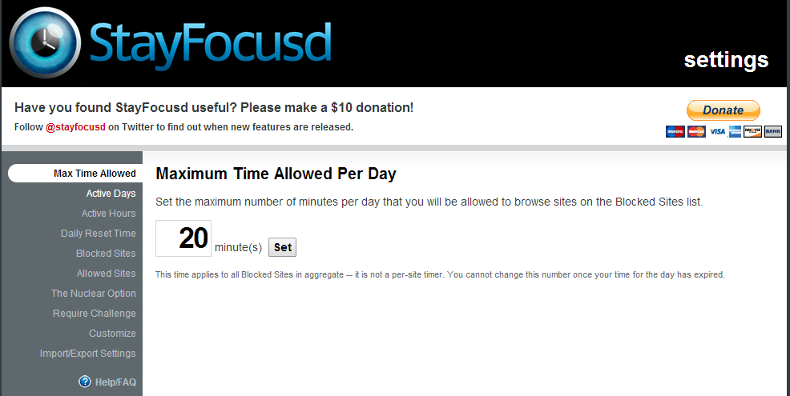
Notes:
StayFocusd options

Slide 19
Manage / Limit
Notes:
Managing and limiting

Slide 20
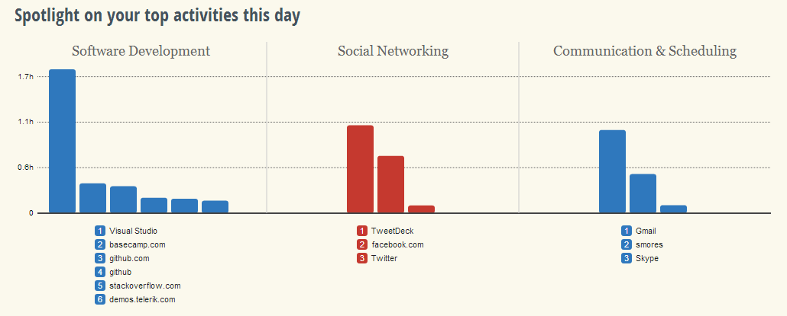
Notes:
Top activities of the day

Slide 21
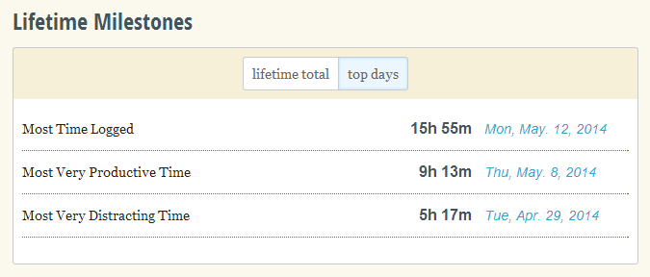
Notes:
Lifetime milestones

Slide 22
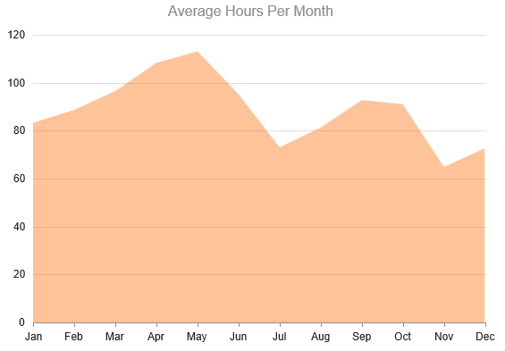
Notes:
My historical time tracking data…
Average Hours Per Month

Slide 23
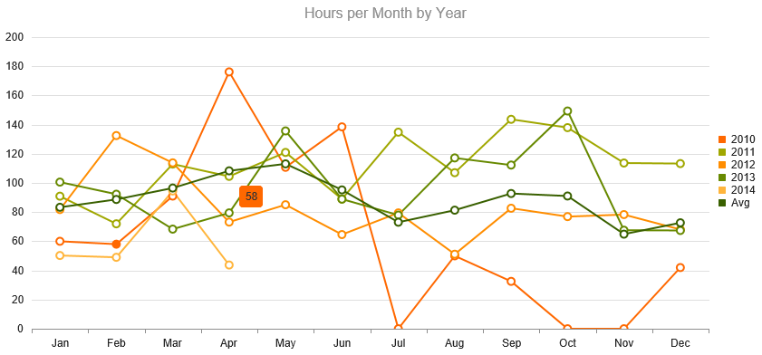
Notes:
My historical time tracking data, hours per month by year

Slide 24
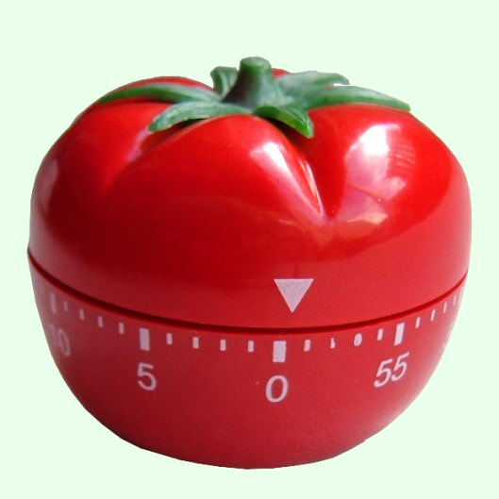

Slide 25
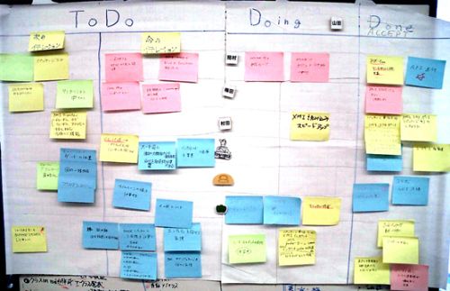

Slide 26
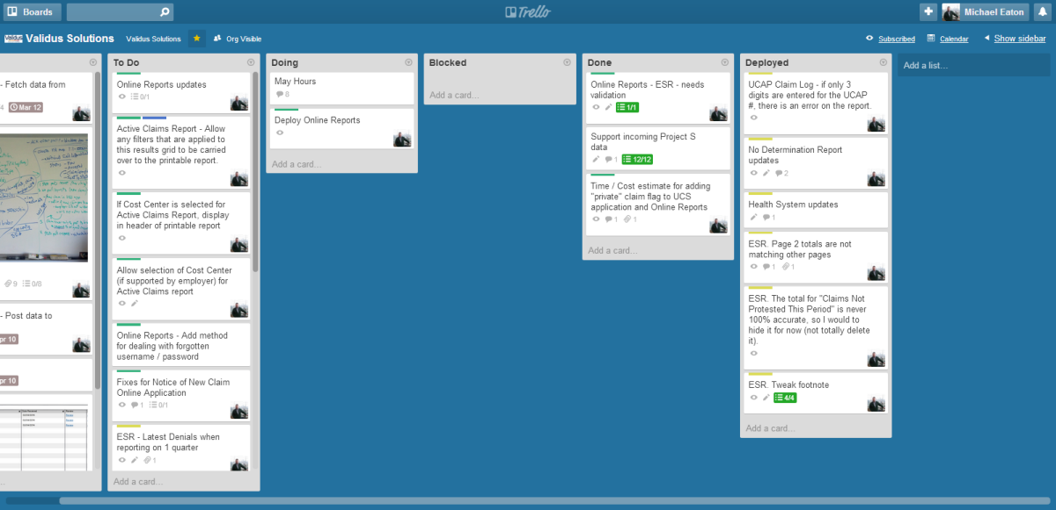

Slide 27
Relax

Slide 28
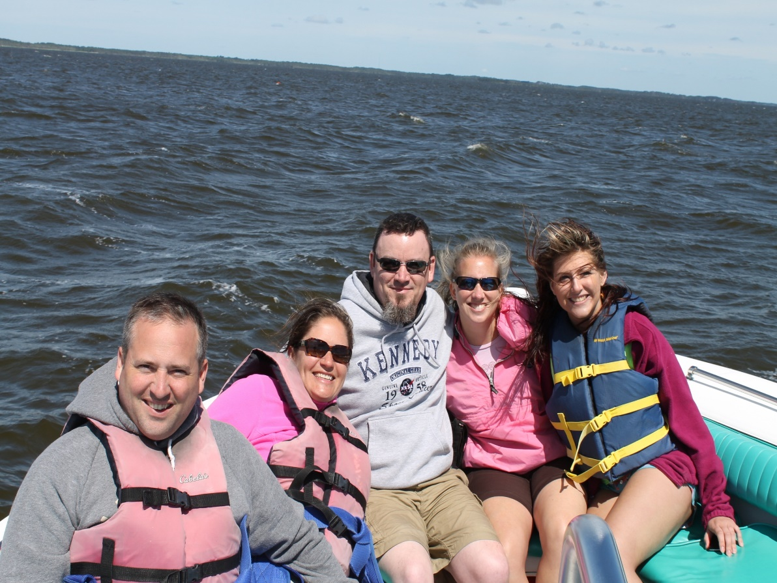
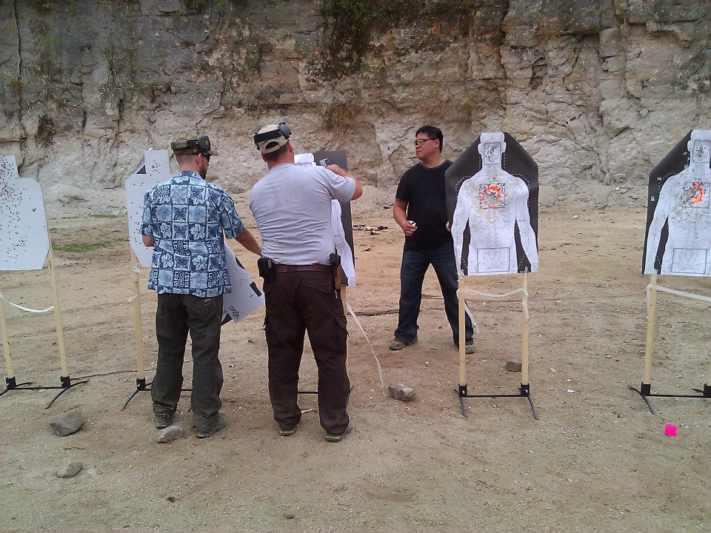
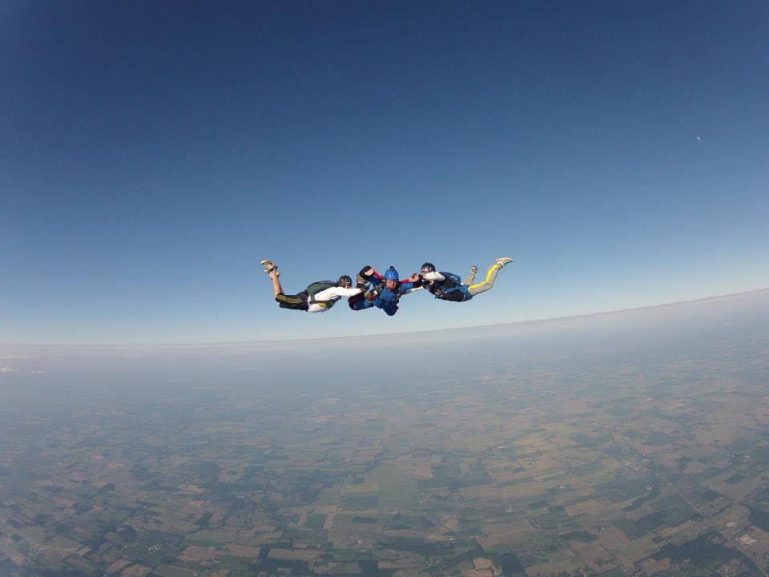
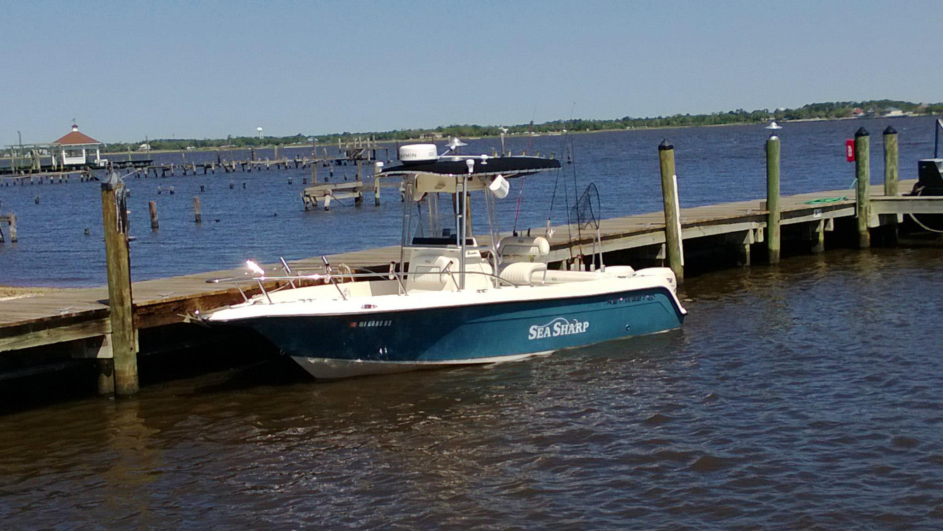

Slide 29
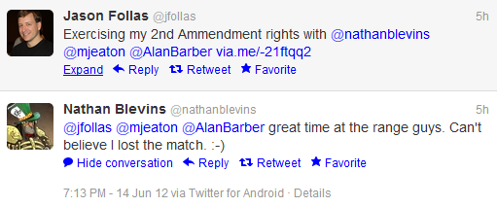

Slide 30
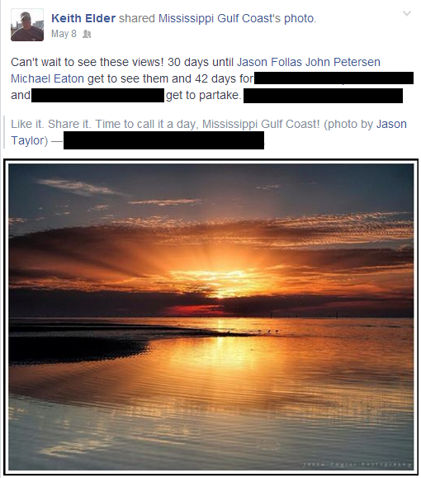

Slide 31
Contact Info
Email: mjeaton@validussolutions.com
Blog: http://mjeaton.net/blog
Twitter: @mjeaton
LinkedIn: http://www.linkedin.com/in/mjeaton

